Slide 1
Best Practices @ OLCF (or, How to OLCF)
Bill Renaud OLCF User Support

Slide 2
General Information
The goal of this presentation is to give a brief introduction to OLCF’s systems and policies
This is by no means an all-inclusive presentation
Feel free to ask questions

Slide 3
OLCF Best Practices
Stay informed
Access the software you need
Discover how Titan & Eos differ from typical clusters
Understand the batch queue system
Master the aprun command
Learn OLCF’s project & allocation policies
Familiarize yourself with available data storage options
Develop a data strategy
Become Lustre® savvy
Optimize HPSS usage
Know how to get help

Slide 4
Best Practice 1: Stay informed

Slide 5
Staying Informed
OLCF provides multiple layers of user notifications about system status and downtimes
Email lists
Status indicators on olcf.ornl.gov
Twitter (@OLCFStatus)
For more information, see the OLCF website: http://www.olcf.ornl.gov/kb_articles/communications-to-users/

Slide 6
Staying Informed Email Lists
Announce lists
All users are required to be members
System-specific (*-announce@email.ornl.gov) & center-wide (ccs-announce@email.ornl.gov) lists
Used for major announcements, weekly notice, etc.
Notice lists
“Recent” users (active within last 2 weeks) are members; permanent opt-in or opt-out available (contact help@olcf.ornl.gov)
System-specific lists only (*-notice@email.ornl.gov)
Used for minor updates, system status, etc

Slide 7
Staying Informed Weekly Update
Sent on Wednesday
Contains announcements about outages, training, etc.
All OLCF users should receive this email

Slide 8
Staying Informed System Status
Logs from monitoring software parsed to make educated guess on system status
Status is sent to multiple destinations
OLCF Website
Twitter (@OLCFStatus)
System “notice” email lists
Fairly accurate, but still a fully automated process
Possibility of both false positives and false negative
We do take some measures to mitigate this

Slide 9
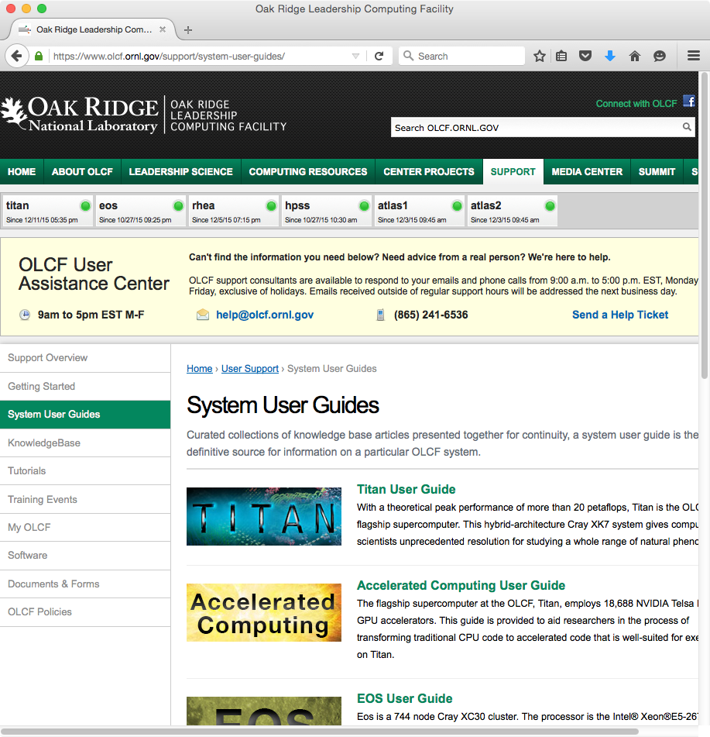
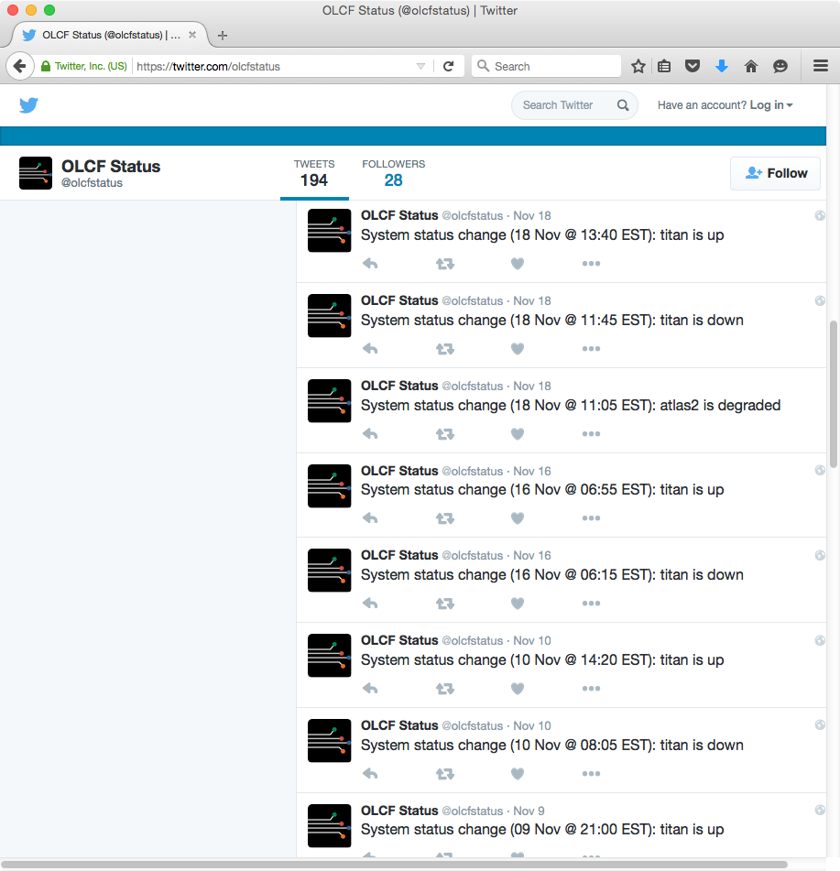
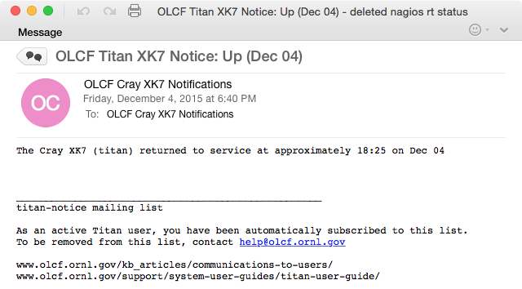
Staying Informed System Status

Slide 10
Best Practice 2: Access the software you need

Slide 11
Finding Software
Basic commands are part of the default environment
Other software is provided via the module command
Compilers, development tools (debugging, profiling, optimization), various libraries & scientific applications are all available
Software information is available on the our website
Available software listing https://www.olcf.ornl.gov/support/software/
Changes to default versions (planned as well as historical) https://www.olcf.ornl.gov/kb_articles/software-news/
Some software documentation is available

Slide 12
Software Availability & Installation
Cray-provided software (compilers, MPI, CUDA, etc.) goes through testing before we receive it (so there’s a delay before we receive it)
You are free to install software in your directories (subject to export control, licensing, etc.)
If you think software would be of general interest, you might ask us to install it for general use
Via the Software Request Form http://www.olcf.ornl.gov/support/software/software-request/
Alternatively, via email to help@olcf.ornl.gov N.B.: Requests are sent our software council for approval

Slide 13
Using Modules
Much of our software is managed with the Environment Modules package
Modules are managed with commands like “module avail”, “module load”, etc.
For detailed information, see online documentation http://modules.sourceforge.net https://www.olcf.ornl.gov/kb_articles/using-modules/
Important notes
Pay attention to dependency error messages when loading/changing modules
On Cray systems, change the PrgEnv module to change compiler (& not the pgi/intel/etc. modules)

Slide 14
Best Practice 3: Discover how Titan & Eos differ from typical clusters

Slide 15
Understanding Titan and Eos
Our Cray XK7 (Titan) and XC30 (Eos) may seem similar to a standard Linux cluster but there are important differences
Heterogeneous nodes (login/service vs. compute nodes)
Compiling
Batch job environment

Slide 16
Titan/Eos Node Types
Titan and Eos are heterogeneous systems
Somewhat specialized nodes for different tasks
Login/service nodes handle general interaction, compiling, and managing batch jobs
If you are typing a command, you’re on a login/service node
Compute nodes simply run parallel jobs
Can only be accessed via aprun (no login access)
Filesystems may differ
Compute nodes don’t mount user home
Compute nodes mount project home, but it is read-only and can be as much as 30 minutes out of date
Different processor, memory, and network configurations

Slide 17
Titan Compute Nodes
16-core AMD Opteron™ processor
Contains 8 “Bulldozer” modules, each with 2 integer cores and a shared floating point unit
1 NVIDIA® Tesla® K20X GPU
32 GB CPU memory plus 6 GB GPU memory
Connects to 3d torus via Gemini ASIC (shared w/1 other node)
Cray terminology (as used in aprun documentation)
Compute Unit – A single Bulldozer module
NUMA Node – A collection of 4 Bulldozer modules
Notes:
ASIC=Application Specific Integrated Circuit

Slide 18
Eos Compute Nodes
2 8-core Intel® Xeon® processors
Hyper-Threading is supported
If enabled, the OS views each physical core as 2 virtual cores
64 GB memory
Connects to Dragonfly interconnect via Aries ASIC (shared w/3 other nodes)
Cray terminology (as used in aprun documentation)
Compute Unit – A single physical core (or 2 virtual cores)
NUMA Node – A single 8 (physical) core Xeon® processor

Slide 19
Compiling for the XK7 and XC30
Because of different node types, you are actually cross-compiling
This can make utilities such as autoconf and cmake challenging to use
Compiling for batch/login nodes
Not common, but occasionally necessary
See §7.2 of the Titan User Guide for examples https://www.olcf.ornl.gov/support/system-user-guides/titan-user-guide/

Slide 20
Compiling for the XK7 and XC30
Controlled by a combination of module files
Compiler commands (C: cc, C++: CC, Fortran: ftn) are common & independent of compiler vendor
Many libraries automatically linked
MPI, Math, Scientific, GPU, etc.
No need to add -lmpi, -lblas, etc.
Another challenge for automated build tools
PrgEnv-? | Loads compiler, math, MPI, etc. modules
craype | Loads compiler wrappers (cc/CC/ftn)
cudatoolkit | Loads GPU libraries
hdf5, netcdf, etc. | Miscellaneous other libraries

Slide 21
Best Practice 4: Understand the batch queue system

Slide 22
Running Batch Jobs
Batch system is TORQUE combined with Moab® (both from Adaptive Computing)
Titan & Eos integrate these with Cray’s ALPS
More detailed batch job/batch queue information is available in our System User Guides on the website
Sample scripts
Queue limits
Scheduling policies
Notes:
ALPS is Cray’s Application Level Placement Scheduler

Slide 23
Running Batch Jobs
Jobs are charged based on what you make unavailable to others, not what you use
If you request 1,000 nodes but only use 1, your project will be charged for 1,000
Charge (core-hours) is computed as:
On Titan & Eos, cores per node = 30
Elsewhere, cores per node = 16
Parallel job launcher differs from system to system
Titan/Eos: aprun
Clusters: mpirun
core-hours = elapsed walltime * nodes allocated * cores per node

Slide 24
Scheduling Basics
The basic priority factor is job submit order
Scheduling policies modify the “apparent” submit time to adjust priority
Scheduling policies differ from system to system based on that system’s mission
e.g. Titan heavily favors leadership-class jobs
Smaller jobs can backfill even if larger jobs have higher priority

Slide 25
Determining Why a Job Isn’t Running
Can be a number of reasons
Insufficient nodes available
Pending downtime
Queue policy
Dependency on another job not met
Use checkjob <jobid> to diagnose
Use -v for verbose mode
Reason for job not running is usually near the end (although the verbiage may be confusing)
Use showres to see upcoming reservations/outages
Also shows running jobs…look carefully

Slide 26
Determining Why a Job Isn’t Running
Insufficient resources available
Unresolved depencency
Queue policy issue
NOTE: job cannot run (insufficient available procs: 3264 available)
NOTE: job cannot run (dependency 1851375 jobcomplete not met)
NOTE: job violates constraints for partition titan (job 1854474 violates active HARD MAXJOB limit of 2 for qos smallmaxjobs user partition ALL (Req: 1 InUse: 2))
BLOCK MSG: job 1854474 violates active HARD MAXJOB limit of 2 for qos smallmaxjobs user partition ALL (Req: 1 InUse: 2) (recorded at last scheduling iteration)

Slide 27
Determining Why a Job Isn’t Running
Pending maintenance period/reservation
This is example output from showres
Look for alphanumeric ReservationIDs (those without letters are likely currently running jobs)
Note the full system reservation starting in 15 hours (PM.128)…is my job asking for more than 15 hours?
ReservationID Type S Start End Duration N/P StartTime
DTNOutage.127 User - 15:05:13 1:03:05:13 12:00:00 11/176 Tue Jan 28 08:00:00
PM.128 User - 15:05:13 1:03:05:13 12:00:00 18688/299008 Tue Jan 28 08:00:00
PM_login.129 User - 15:05:13 1:03:05:13 12:00:00 16/2048 Tue Jan 28 08:00:00

Slide 28
Determining When a Job Will Start
Can be difficult to tell since jobs submitted in the future can affect it
Several utilities can give a general idea of start time
showstart <jobid> is not always reliable
showq output is sorted by priority (can be helpful)
mdiag -p gives detailed priority info
Shows boosts based on job size
Shows overallocation penalties

Slide 29
Dealing With Failed Nodes
Sometimes nodes fail when your job starts
Since node allocation has already happened, the batch system can’t replace them
You can work around this by requesting “extra” nodes
#!/bin/bash
#PBS –lnodes=104
...
APRUN_RETURN_VALUE=1
while [[ $APRUN_RETURN_VALUE –ne 0 ]]; do
aprun –n1600 ./a.out
APRUN_RETURN_VALUE=$?
done
...

Slide 30
Best Practice #5: Master the aprun command

Slide 31
Important aprun Options
Option | Description
-n | Total number of MPI tasks
-N | Number of MPI tasks per physical node (<=16 on Titan, varies on Eos)
-S | Number of MPI tasks per NUMA node (<=8 on Titan, varies on Eos)
-d | Reserve this number of cores for each MPI task & its threads
-j | Number of tasks per Compute Unit On Titan, -j1 idles 1 core per Bulldozer, -j2 uses both cores On Eos, -j1 disables Hyper-Threading while -j2 enables it
-cc | Binds tasks to cores (prevents the OS from migrating tasks between cores within a node)
-r | Assigns system services to a compute core. Specified as -r1. Reduces the cores available for your code, but may improve performance by preventing unexpected context switches (i.e. limits “jitter”)

Slide 32
aprun Environment Variables
Variable | Description
OMP_NUM_THREADS | Number of OpenMP threads to spawn per MPI task (can also be controlled by calls in the code)
MPICH_RANK_REORDER_METHOD | Controls how tasks are placed on nodes
 | 0: Round robin 1: SMP style 2: Folded 3: Custom | [0+4], [1+5], [2+6], [3+7] [0+1], [2+3], [4+5], [6+7] [0+7], [1+6], [2+5], [4+3]
MPICH_RANK_ORDER | The name of a file which contains the rank order for MPICH_RANK_REORDER_METHOD=3
APRUN_XFER_LIMITS | If set, shell limits (i.e. things set with limit or ulimit) will be passed to the compute nodes

Slide 33
aprun Notes
For OpenMP codes, you must use both OMP_NUM_THREADS and the -d option to aprun
The system spawns the number of threads specified by OMP_NUM_THREADS (or appropriate calls in the code)
The system schedules those across the number of cores reserved by the -d option N.B.: If you don’t specify a -d option, the system will default to 1…meaning all threads go to a single core!

Slide 34
aprun Notes
Floating-point-intensive codes on Titan may get better performance with -j1 (i.e. “idle” one integer core per Bulldozer)
No, this is not “wasting” half of your cores!
Consider the total aprun task layout you’ve requested when determining how many nodes your job needs
Don’t run >100 simultaneous aprun commands (If you need to do this, contact us about wraprun)
For more information/documentation, try “man aprun” and/or “man intro_mpi”

Slide 35
Common aprun Error Messages
aprun provides a great deal of control in task layout
Because of this flexibility, it can be easy to request a task layout that cannot be fulfilled
Any of several error messages will be provided if there is a job layout problem
These are described on the upcoming slides
There are very subtle differences between these errors and it’s easy to get confused, so feel free to ask questions
There’s a slide showing some examples that lead to these errors…feel free to try your own experiments

Slide 36
Common aprun Error Messages
aprun: [NID 94]Exec a.out failed: chdir /autofs/na1_home/user1 No such file or directory
You tried to access a non-existent directory on a compute node (the key is “No such file or directory”)
When aprun starts a task on a compute node, it will cd into the $CWD of the shell from which aprun was called
Remember, compute nodes don’t mount all directories
Your batch script starts in $HOME, so you’ll always need to do a cd
To fix, run aprun from a directory visible to compute nodes Also remember to place input files, .so files, etc. in directories visible to compute nodes (failure to do so won’t cause this error, but this seems like a logical place to mention it)

Slide 37
Common aprun Error Messages
apsched: claim exceeds reservation's node-count
You are trying to use more physical nodes than are available to your job because…
The aprun request requires more nodes than the job requested, or
Your request was correct, but at launch time some nodes were discovered to be down (see potential fix later in this presentation)
To fix
Double-check your aprun/node request and re-submit
If the request appears to be correct, you may wish to contact us to see if there were node failures

Slide 38
Common aprun Error Messages
apsched: claim exceeds reservation’s CPUs
There’s a problem with the intra-node layout of your job
You’re requesting more NUMA nodes than are present on the physical node (i.e. -N4 -S1)
You’ve “deactivated” half of your cores with –j1, but your remaining aprun options require some/all of the deactivated cores (i.e. -j1 -S8 on Titan or -j1 -S16 on Eos)
To fix, modify your aprun command to ensure
You’re not requesting more NUMA nodes than are present on each physical node (currently 2 for both Titan and Eos)
You’re not idling cores/disabling Hyper-Threading while simultaneously requesting those resources via -S, -d, or other options

Slide 39
Common aprun Error Messages
apsched: -S value cannot exceed max CPUs/NUMA node apsched: -S times -d cannot exceed max CPUs/NUMA node
You’re trying to use more cores per NUMA node than are physically present
The “exceeds reservation’s CPUs” error is similar but indicates the NUMA node has enough cores but you’ve deactivated some; this error means it doesn’t have enough cores no matter what
To fix, make sure your -S request (or -S times -d if you specify both) is less than the number of cores per NUMA node (8 for Titan; 16 for Eos)

Slide 40
Examples of apsched errors
Examples assume 1 Titan node (16 cores—2 NUMA nodes w/8 cores each)
$ aprun -n4 -N2 ./a.out apsched: claim exceeds reservation's node-count …because 4 tasks (-n4) @ 2 per node (-N2) requires 2 nodes but we only have 1
$ aprun -n2 -S1 -j1 -d8 ./a.out apsched: claim exceeds reservation's CPUs …because -S1 with -d8 requires all 8 cores per NUMA node, but -j1 idles half of them
$ aprun -n4 -N4 -S1 ./a.out apsched: claim exceeds reservation's CPUs …because -N4 with -S1 requires 4 NUMA nodes/node, but there are only 2
$ aprun -n4 -S2 -d16 ./a.out apsched: -S times -d cannot exceed max CPUs/NUMA node …because -S2 with -d16 requires 32 cores/NUMA node, but there are only 8
$ aprun -n16 -S16 ./a.out apsched: -S value cannot exceed max CPUs/NUMA node …because -S16 requires 16 cores/NUMA node, but there are only 8

Slide 41
Best Practice 6: Learn OLCF’s project & allocation policies

Slide 42
System and Group Access
Projects are
Granted access to systems
Assigned specific Unix groups
Users are assigned to projects & “inherit” the project’s system accesses & Unix groups
Users aren’t directly added to systems/groups
To access another group’s data, you need to join their project –or– have them place the data in $WORLDWORK

Slide 43
Finding Your Project’s ID and Allocation
Use showproj and showusage to list projects and usage, respectively
Both commands have a help option (run with -h)
$ showproj
user1 is a member of the following project(s) on titan:
abc123
$ showusage
titan usage for the project's current allocation period:
Project Totals user1
Project Allocation Usage Remaining Usage
__________________________|____________________________|_____________
abc123 7350000 | 11138 7338862 | 12

Slide 44
Managing Your Allocation
Projects are NOT disabled for going over allocation
But jobs will have a lower priority to facilitate some degree of “fairshare” with projects that have allocation remaining
30 day penalty for slightly over (usage 100-125% of allocation)
365 day penalty for usage >125% of allocation
Since we don’t disable projects, we don’t issue refunds (per se)
If many jobs were affected by a system issue, let us know (we can delay the priority reduction)
This has the same effect as a refund but is easier to manage

Slide 45
Project Closeout
When your project ends, you’ll no longer be able to access OLCF resources
Even if you’re continuing on other projects, you won’t be able to access the closed project’s storage areas
Users will be given a month for data retrieval
You won’t be able to access the main resources…you will need to use the Data Transfer Nodes

Slide 46
Best Practice 7: Familiarize yourself with available data storage options

Slide 47
Data Storage Locations
User-centric and project-centric areas
Home, work (scratch), and archival areas
Multiple storage technologies
Storage Area | Technology | Location*
User home | NFS | /ccs/home/$USER
Project home | NFS | /ccs/proj/project_id
User work | Lustre® | $MEMBERWORK/project_id
Project work | Lustre® | $PROJWORK/project_id
Globally-shared work | Lustre® | $WORLDWORK/project_id
User archive | HPSS | /home/$USER
Project archive | HPSS | /home/project_id
*These are the recommended ways to reference the different locations; they’re not necessarily the absolute path names.

Slide 48
Directory Permissions
Home directory permissions
User home default is 0750 & can be changed
Project home is 0770 & can’t be changed
Archive directory permissions
User home default is 0700 & can be changed
Project home is 0770 & can’t be changed
Scratch directory permissions can’t be changed
$MEMBERWORK, $PROJWORK, & $WORLDWORK have different defaults (see the Data Management User Guide)
Move files between scratch areas instead of changing permissions on the current directory

Slide 49
Data Backups
NFS directories are backed up to a limited extent
Hourly/daily/weekly snapshots are in /autofs/nccs-svm1_home?/.snapshot
ls -lnd /ccs/home/$USER will tell you which subdirectory of /autofs to use
Note: -n not really needed…simply used for brevity (numeric uid/gid)
Lustre® is not backed up
HPSS is not backed up
$ ls -lnd /ccs/home/$USER
lrwxrwxrwx 1 0 0 31 May 26 2015 /ccs/home/user1 -> /autofs/nccs-svm1_home2/user1

Slide 50
Monitoring Storage Usage
For home directories, use the quota command
For Lustre® directories, use lustredu
For archive directories, use showusage
$ quota quota: error while getting quota from master:/cm/shared for user1 (id 98765): Connection refused quota: error while getting quota from master:/home for user1 (id 98765): Connection refused
Disk quotas for user user1(uid 98765):
Filesystem blocks quota limit grace files quota limit grace
nccsfiler3.ccs.ornl.gov:/vol/home1
8 10485760 10485760 2 4294967295 4294967295
nccsfiler4.ccs.ornl.gov:/vol/home2
8669108 15728640 15728640 51766 4294967295 4294967295
$ lustredu $MEMBERWORK/stf007
Last Collected Date Size File Count Directory
2014-01-10 12:30:08 31.21 MB 9 /lustre/atlas1/stf007/scratch/user1
$ showusage -s hpss HPSS Storage in GB: Project Totals user1 Project Storage Storage _____________|_________________|_____________ user1 | 550.65 | 550.65 abc123 | 2107.18 | 106.52

Slide 51
Data Storage Documentation
Data Management User Guide https://www.olcf.ornl.gov/computing-resources/data-management/data-management-user-guide/
Data Management Policy https://www.olcf.ornl.gov/kb_articles/data-management-policy

Slide 52
Best Practice 8: Develop a Data Strategy

Slide 53
Data Considerations
OLCF systems can generate large volumes of data very quickly
It’s important to develop a project data strategy as soon as possible
Several things to consider
Where project members will store data
File ownership/permissions
Transferring data to other locations

Slide 54
Data Accessibility
Files in the project work area will often inherit the project’s group id
May not be the case for multiple levels of subdirectories
Still must consider file ownership and permissions
Users have no control over ownership (can’t run chown)
Users can control permissions with chmod and umask
Try to catch issues early (much easier to “fix” hundreds of files than tens of thousands)

Slide 55
Transferring Data
Data transfer nodes (dtn.ccs.ornl.gov) are the preferred place for external data transfer
Titan external login nodes & batch nodes work well for internal HPSS transfers
Several ways to transfer your data
External (to OLCF): bbcp, scp, gridftp, globus.org
Internal: hsi/htar along with those listed above
Start early/transfer data as it’s generated

Slide 56
Data Transfer Documentation
System User Guides https://www.olcf.ornl.gov/support/system-user-guides/
Data Management User Guide https://www.olcf.ornl.gov/computing-resources/data-management/data-management-user-guide/
Presentations from prior training events https://www.olcf.ornl.gov/wp-content/uploads/2015/02/Data-Transfer-Options1.pptx

Slide 57
Best Practice 9: Become Lustre® savvy

Slide 58
Lustre®
We’ll use some Lustre® terms, but a full discussion of it is beyond the scope of this talk (but can be found on the website) https://www.olcf.ornl.gov/kb_articles/lustre-basics/
It’s critical that you understand your application’s I/O …otherwise it is difficult to apply these best practices
The upcoming slides summarize data from
Our Spider Best Practices page https://www.olcf.ornl.gov/kb_articles/spider-best-practices/
Sarp Oral’s IO Best Practices presentation from the 2015 User Meeting https://www.olcf.ornl.gov/wp-content/uploads/2015/02/OLCF-IO-Best-Practices.pdf

Slide 59
Lustre® Striping
Lustre “stripes” files across multiple storage targets
lfs getstripe shows the striping of an existing file/directory
lfs setstripe sets striping for a new file/directory
You have control over several stripe characteristics
count: The number of OSTs over which the file is striped
size: The size of each file chunk
index: The OST on which the first stripe will be placed
There are some settings that should be avoided (see the next few slides)
General theme: minimize impact on metadata

Slide 60
Lustre® Best Practices
When setting up striping…
Use a stripe count of 1 for small files or for directories that will contain many small files
Use a stripe count greater than the default (which is currently 4) for large, shared files
…and do not…
Use a stripe count >512
Use a stripe count of -1 (stripes over all OSTs)
Use a stripe index (starting OST) other than -1
Stripe your entire scratch area wholesale

Slide 61
Lustre® Best Practices
Avoid editing/building/compiling in Lustre®
Use ls -l only when absolutely necessary
Perform stat operations from a single task
Open files read-only whenever possible
Read small, shared files from a single task
Don’t fill up individual OSTs
Use large and stripe-aligned I/O whenever possible
Limit the number of files in a single directory
Use high-level I/O libraries/middleware if possible ADIOS, HDF5, pNetCDF, community-developed libraries, etc.

Slide 62
Lustre® Purge Guidelines
Lustre® is regularly purged (i.e. old files are deleted) to ensure ample free space & optimal performance
See the Data User Guide for the purge interval (different areas are purged at different intervals)
No notice—archive important files as soon as possible!
Delete files as soon as you know they’re not needed
The purge is an overall good, but can be troublesome (i.e. files purged before your job starts)
Easiest way to handle is to have your job check for needed files & do an hsi get if they’ve been purged
Please don’t do a wholesale touch operation

Slide 63
Best Practice 10: Optimize HPSS usage

Slide 64
The High Performance Storage System
HPSS is the proper location for long-term storage
Project home and project work areas offer a common area for files shared among project members, but neither are long-term storage
Home areas are somewhat space constrained
Lustre® areas are subject to the purge
There’s still a need for a backup location
HPSS is accessed via the hsi and htar commands

Slide 65
HPSS Best Practices
Don’t run multiple simultaneous transfers
You’re likely not getting the parallelism you expect
File size best practices
For optimal transfer performance, use files ≥ 768GB
Minimum recommended file size is 512MB
Smaller files will be handled but read/write performance may be negatively affected
If you have numerous small files, we recommend bundling with htar to achieve the 512MB threshold
When using htar, no individual member file can be ≥ 64GiB (but the archive itself can be)
Avoid numerous consecutive hsi get calls

Slide 66
HPSS Best Practices
Bad practice-successive hsi get calls
Good practice-create a list file & call hsi once
$ hsi get file1
$ hsi get file2
$ hsi get file3
$ hsi get file4
$ cat getfiles.lst
get <<EOF
file1
file2
file3
file4
EOF
$ hsi “in getfiles.lst”

Slide 67
Best Practice 11: Know how to get help

Slide 68
Where do I find documentation?
OLCF Website/System User Guides https://www.olcf.ornl.gov https://www.olcf.ornl.gov/support/system-user-guides/
CrayDocs http://docs.cray.com
NVIDIA hosted documentation http://docs.nvidia.com

Slide 69
Training Opportunities
We host numerous training events through the year
Monthly User Conference Call
Software-specific courses
GPU Hackathons
Watch for announcements in the Weekly Update

Slide 70
Working With User Support
Email is often the best option to contact us
Especially for sending long/complicated error messages
Send as many error messages as possible (or place them in a file & direct us to the file)
“Send” us codes by creating a .tar file & directing us to it
$WORLDWORK, anyone?
More efficient that sending code/.tar file via email
Include all files necessary to run
Start a new ticket for new issues instead of replying to an old ticket
Helps us in classifying/searching through old tickets
Gives it greater visibility

Slide 71
Requesting a priority boost/higher walltime limit/purge exemption/etc
Request can be made from our Documents & Forms page (in the third section of the page) https://www.olcf.ornl.gov/support/documents-forms/
Reviewed by Resource Utilization Council, so make requests well in advance to allow for review
If requesting job priority, make sure you submit the job…they often run more quickly than you expect

Slide 72
OLCF Best Practices
Stay informed
Access the software you need
Discover how Titan & Eos differ from typical clusters
Understand the batch queue system
Master the aprun command
Learn OLCF’s project & allocation policies
Familiarize yourself with available data storage options
Develop a data strategy
Become Lustre® savvy
Optimize HPSS usage
Know how to get help

Slide 73
Finally…
We’re here to help you
Questions/comments/etc. can be sent to the OLCF User Assistance Center
Staffed 9AM – 5PM US Eastern Time (exclusive of ORNL holidays)
help@olcf.ornl.gov
(865) 241-6536

Slide 74
THANK YOU!

Slide 75
Bonus Material

Slide 76
Best Practice 12: Authentication Basics

Slide 77
Authenticating to OLCF Systems
Interactive login access to OLCF systems is via Secure Shell (SSH)
Our systems use “two-factor” authentication via user-selected PINs and RSA SecurID tokens
“Two-factor” means you’re using two of the three methods of user identification/authentication
Something you have: Your SecurID token which generates pseudorandom, time-sensitive codes
Something you know: Your PIN, which only you know
We don’t use the third, something you are (e.g. biometrics)
Other authentication methods, such as password and public key authentication, are not permitted

Slide 78
Common Login Issues
SSH doesn’t prompt for a username
By default, it uses your username on the client system
You must tell SSH if your username differs
Command line: ssh olcfusername@home.ccs.ornl.gov
Can set this in ~/.ssh/config file
Various ways to do this in graphical SSH clients
SSH won’t tell you what username it’s using

Slide 79
Common Login Issues
SSH prompts for a password
Typically happens after three PASSCODE failures
This is a fallback behavior of SSH
If you see this, kill the process (Ctrl-C) & try again
We don’t use passwords, so there’s nothing you can enter that will work
Enter PASSCODE:
Enter PASSOCDE:
Enter PASSCODE: user1@titan.ccs.ornl.gov’s password:

Slide 80
Common Login Issues
RSA token gets out of sync with the server
Sometimes you may be prompted for the ‘next tokencode’
Tokencode: The 6 digit number on your RSA token
PIN: The 4-8 digit number known only to you
PASSCODE: Your PIN followed by the current tokencode
When this happens, enter (only) the next tokencode your RSA token generates
Enter PASSCODE: Wait for the tokencode to change, then enter the new tokencode :

Slide 81
Miscellaneous RSA/SSH Tips
Once you’ve used a tokencode, you can’t re-use it
If your PASSCODE has failed twice, let the tokencode change before you try again
Numerous failed attempts will result in your token being locked out

