Slide 1
Using Darshan on Titan
Verónica G. Vergara Larrea
OLCF Users Conference Call
August 26, 2015

Slide 2
Darshan on Titan
Requested in the July 2015 OLCF Users concall
I/O profiling tool developed by Argonne National Lab
Where can I find it?
darshan/2.3.1 module on Titan
How do I use it?
Captures I/O operations (read, writes, creates, etc.)
Executable must be linked against Darshan libraries
Load the Darshan module and compile a static executable
Run application as usual
Analyze logs produced using Darshan utilities
Darshan example:
https://www.olcf.ornl.gov/kb_articles/darshan-basics/

Slide 3
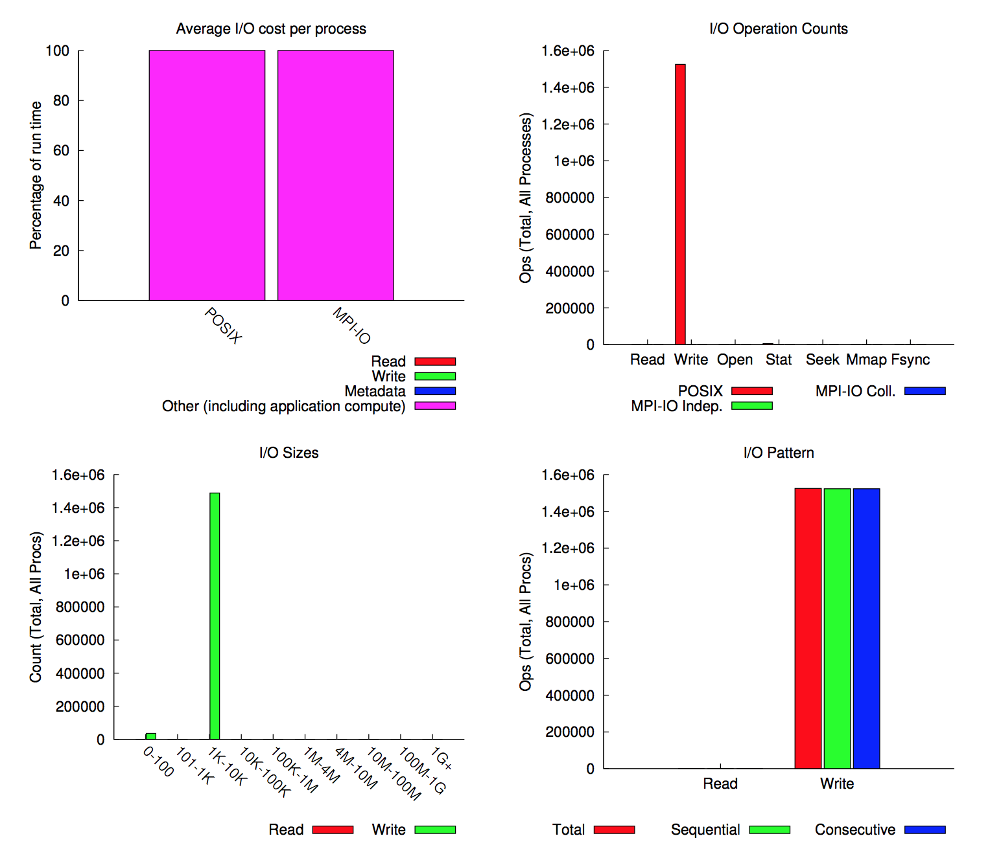
Profiling your code with Darshan
$ module load darshan
$ export DARSHAN_LOGPATH=$MEMBERWORK/<projID>/<username>/myLogs
$ cc -o hello.titan hello-mpi.c
$ aprun -n 1 ./hello.titan
$ darshan-parser --all $DARSHAN_LOGPATH/<darshan log>
# Per-file summary of I/O activity.
# : hash of file name
# : last 15 characters of file name
# : MPI or POSIX
# : number of processes that opened the file
# : (estimated) time in seconds consumed in IO by slowest process
# : average time in seconds consumed in IO per process
# 17249959986228912358 _darshan/sds.h5 MPI 2 0.007429 0.005239

