Slide 1
Tools Available for Transferring Large Data Sets Over the WAN
Suzanne Parete-Koon
Chris Fuson
Jake Wynne
Oak Ridge Leadership Computing Facility

Slide 2

Data Management Users Guide
We have organized a Data Management User Guide
Data management policy
Directory Structures of the filesystems
Data transfer
Look for this icon on the systems guide page:

Slide 3
Network File Service
 | User home | Project home
Description | Home directories are located in a Network File Service (NFS) that is accessible from all OLCF resource. You login to this location. COMPILE HERE | Storage area in the Network File Service (NFS) mounted filesystem intended for storage of data, code, and other files that are of interest to all members of a project. COMPILE HERE
Location | /ccs/home/$USER. | /ccs/proj/[projid]
Quota | 10 GB (default) | 50 GB
Purge | Never Purged and always backed up | Never
Access | Full access to the user, read and execute for the group | Full access to user and group.

Slide 4
Directory Structure
 | Member Work | Project Work | World Work
Description | Scratch area | Scratch Area for Sharing data within a project | Scratch Area for sharing data between projects.
Location | $MEMBERWORK | $PROJWORK | $WORLDWORK
Quota | 10 TB | 100 TB | 10TB
Purge | 14 days | 90 days | 14 days
Access | May alter permissions to share with project | All project members have access | All OLCF users can access

Slide 5
Data at the OLCF

Slide 6
Data Transfer Nodes
4 Interactive dtn
8 Batch schedulable dtn
7 Batch scheduled dtn dedicated just for HSI transfers to/from the hpss. Triggered only from the Titan Login nodes for HSI (not HTAR)

Slide 7
Moving to/from the HPSS archive
Send a file to the hpss
hsi put file.txt
Get a file from the HPSS
hsi get file.txt
https://www.olcf.ornl.gov/kb_articles/transferring-data-with-hsi-and-htar/
Files over 1TB in size get RAIT- This is like having two copies on tape, so data is not lost in a tape failure, however it takes up less space than two copy.

Slide 8
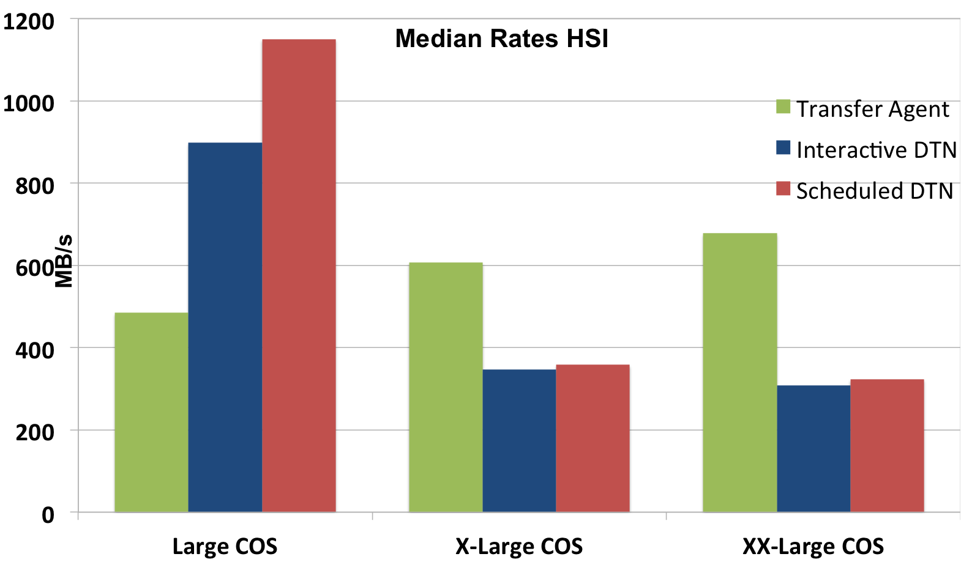
Moving to/from the HPSS archive

Slide 9
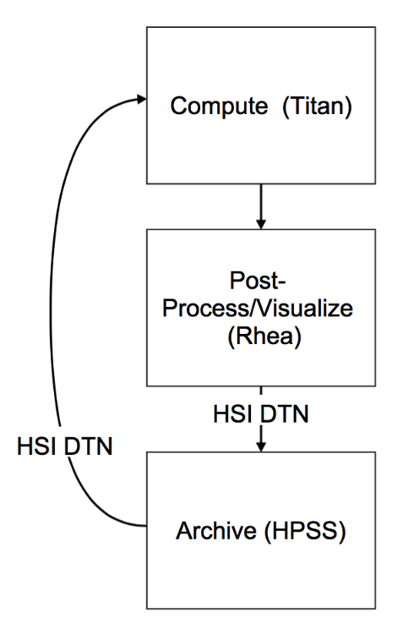
Batch DTN Example
You can script data transfers as part of your workflow.
How to Cross submit jobs:
The Key is -q host script.pbs which will submit the file script.pbs to the batch queue on the specified host.
https://www.olcf.ornl.gov/kb_articles/cross-system-batch-submission/

Slide 10
Data Transfer Tools
OLCF Available
Selection
Scp
Rsync
Bbcp
GridFTP
Globus
Availability?
Handle failure?
Authentication?
Data Validation?
Speed?

Slide 11
Tool Availability
Is the tool available on both client and server?
If not, can I install and do I need to open ports?
scp, rsync
Available on most UNIX-like systems
bbcp, GridFTP
Requires installation
Binary, rpm, code available
Globus
Endpoints
OLCF endpoint olcf#dtn

Slide 12
Does the tool handle failure?
Large/long transfers should plan for possible timeout/failure
Tool | Restart
scp | No
rsync | ‘--partial’
bbcp | ‘-a -k’
GridFTP | ‘-sync’
Globus | Yes
rsync
automatically checks size and modification time
Without ‘--partial’ will delete partial files
bbcp
without ‘-k’, file removed upon failure
‘-a’ create checkpoint file in ~/.bbcp

Slide 13
Authentication
One time or reoccurring transfer?
Workflows
Automate transfer process
Each tool has scriptable command line interface
ssh
X.509 Certificates
Globus, GridFTP
Globus easier to use differing endpoint certificates

Slide 14
Data Validation
Verify copied data now or question latter?
Tool | Validation
scp | No
rsync | default
bbcp | ‘-E md5’
GridFTP | ‘-sync-level 3’
Globus | Yes
Expensive
scp
use md5sum
GridFTP
Re-transfer
‘-sync –sync-level 3’

Slide 15
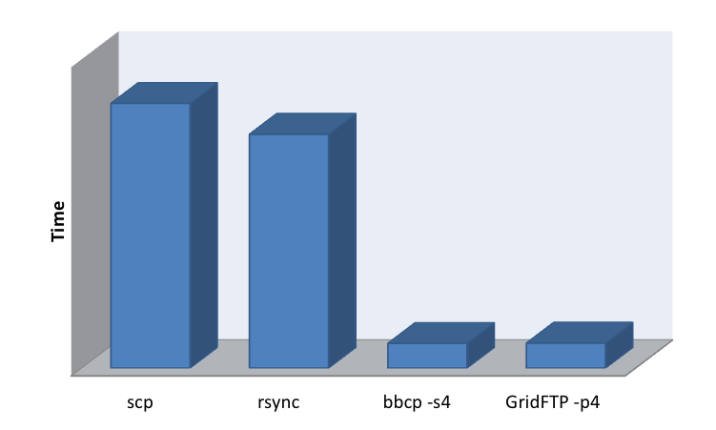
Data Transfer Software
Break the transfer up into multiple parallel streams
Speeds for tools:
4 parallel streams:
bbcp –s4
GridFTP –p4
SCP
rsync
BBCP
GridFTP

Slide 16
Transfer to NERSC

Slide 17
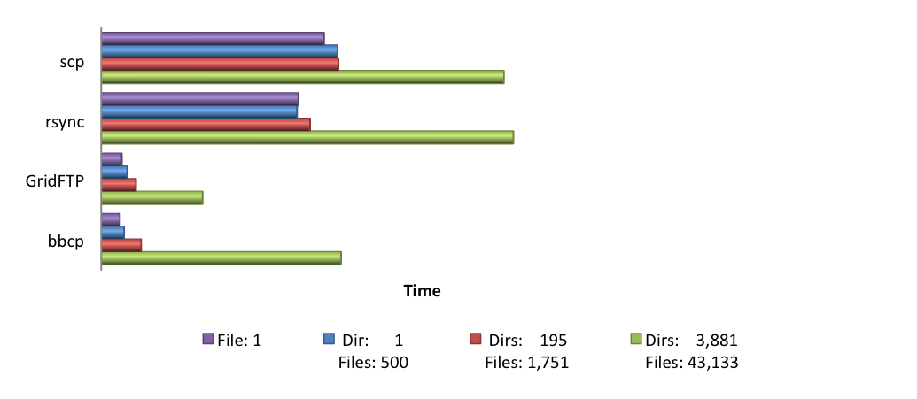
Speed: Data Size and Structure
How is your data stored?
Consider combining many small files into larger files
GridFTP increase concurrent FTP connections: ‘-cc’
bbcp use program pipes instead of ‘-r’:
Overhead for large numbers of files/directories
bbcp -N io 'gtar -c -O –C /local/path DirToTransfer' ’RemoteSys:gtar -x –C /remote/path’

Slide 18
Other Considerations
Connection between endpoints and firewalls
Client/Server configuration
cpu speed, memory
Filesystem
Shared resources
Variable load, variable transfer times
Reduce data to transfer
Should I transfer everything?
Compression
depends on data and cost

Slide 19
Questions/Feedback
We would like to hear from you
Workflow, problems, goals, suggestions
Email
help@olcf.ornl.gov
More information
www.olcf.ornl.gov/support/system-user-guides

