Slide 1
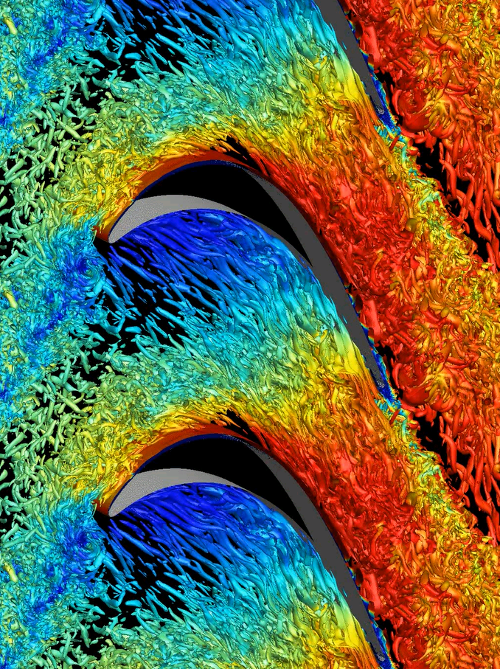
Industrial Impact of High-fidelity Simulations of Low- and High-Pressure Turbines
V. Michelassi - Chief Engineer, GE Oil&Gas/Aviation
G. Laskowski – Principal Engineer, GE Aviation
2015 OLCF Users Meeting: Reaching for the Summit Together

Slide 2
Outline
GE motivation and interest
Unsteady effects in low-pressure-turbines
  DNS to investigate unsteady loss generation
  High-pressure turbines
  DNS to investigate heat transfer and pressure waves
URANS
Outlook

Slide 3

GE business units
Interest in LPT/HPT

Slide 4
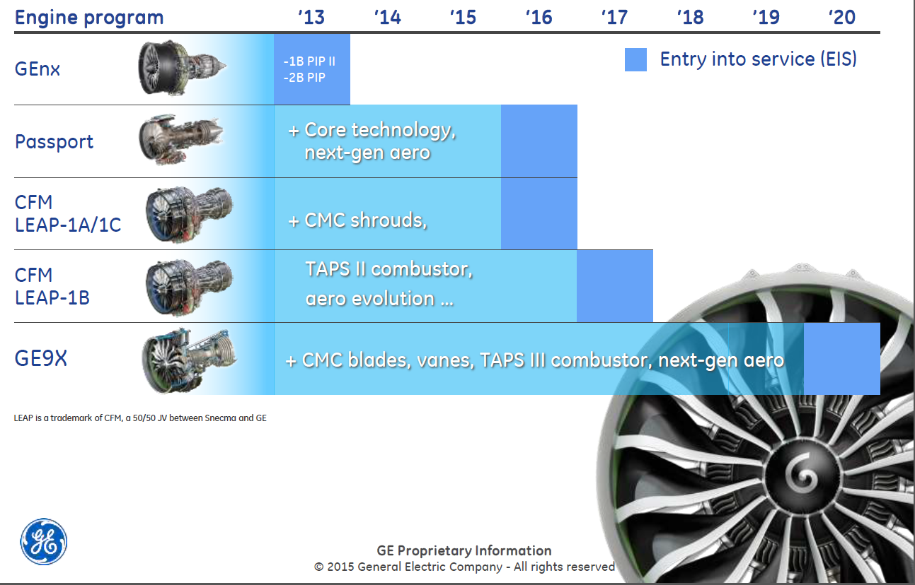
Building on technology investments
Aerodynamics and heat transfer physics key to success

Slide 5
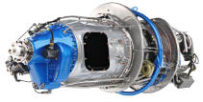
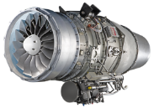
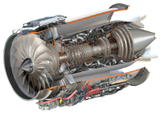
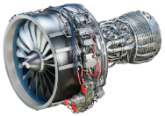
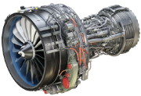
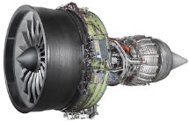
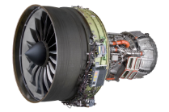
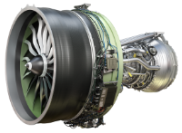
GE Aviation commercial products
Today’s airline
service
Today’s investment
Installed base (2015F)
Regional/
Business
9,600
85M flight hours
H80
HF120
GE Passport
Narrowbody
20,
700
590M flight hours
LEAP-1A
LEAP-1B
LEAP-1C
Widebody
6,800
400M flight hours
GEnx-1B
GEnx-2B
GE9X
~12,700 engines (backlog + wins)
~$1.6B R&D per year
CFM is a 50/50 JV between GE and Snecma
EA is a 50/50 JV between GE and Pratt & Whitney
HF120 is made by GE Honda, a 50/50 JV between GE and Honda Aero, Inc.
LEAP is a trademark of CFM International

Slide 6
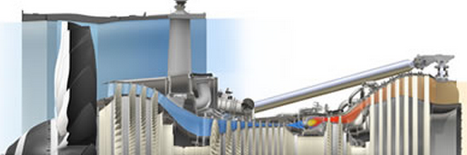
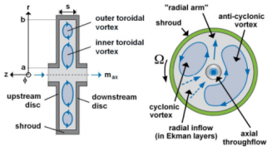
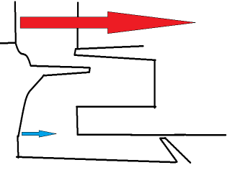
(U)RANS CFD assisted design of T/M
URANS not too bad.
Some key misses.
Span-wise mixing
Hot streaks diffusion
S
Wake decay/mixing
R
T0
T0
T0
Early separation and late reattachment
Film-cooling mixing
P0
Propulsion jet performance and noise
?
HPC Inter-disk cavity bore flow pumping
EXP
CFD
T0
Coolant mixing in wakes
Ingestion prediction

Slide 7
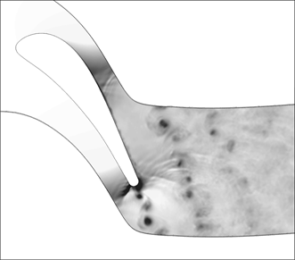
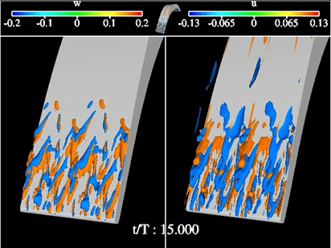
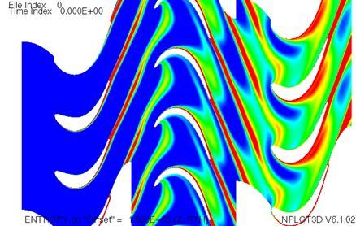
Unsteadiness and turbulence in T/M
Low Frequencies
Intermediate Frequencies
High Frequencies
Blade-to-blade
interaction:
5-10KHz
DETERMINISTIC
Larger flow
structures:
10-50KHz
DETERMINISTIC+STOCHASTIC
Small flow
structures
turbulence:
50 KHz
STOCHASTIC

Slide 8
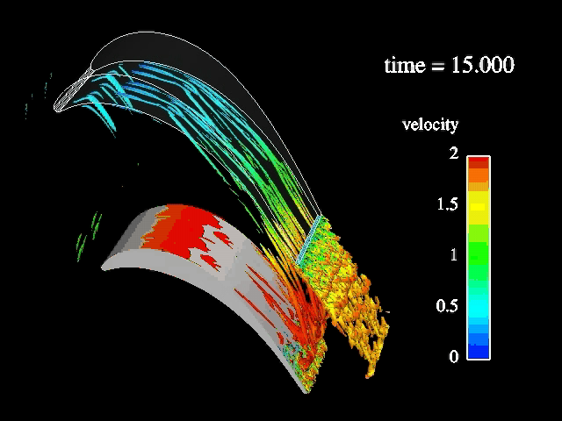
Frequencies and scales all combined
Interaction among different frequencies and scales is key
Notes:
THIS LES MOVIE TRIES TO VISUALIZE THE IMPACT OF INCOMING WAKES ON PROFILE LOSSES. MOST LOSSES IN A LPT PROFILE ARE GENERATED CLOSE THE SUCTION SIDE FROM PEAK SUCTION TO TRAILING EDGE. THE RED SPIKES ARE PROPORTIONAL TO THE TURBULENT NATURE OF THE BOUNDARY LAYER, THE MORE TURBULENT THE MORE LOSSY.

Slide 9
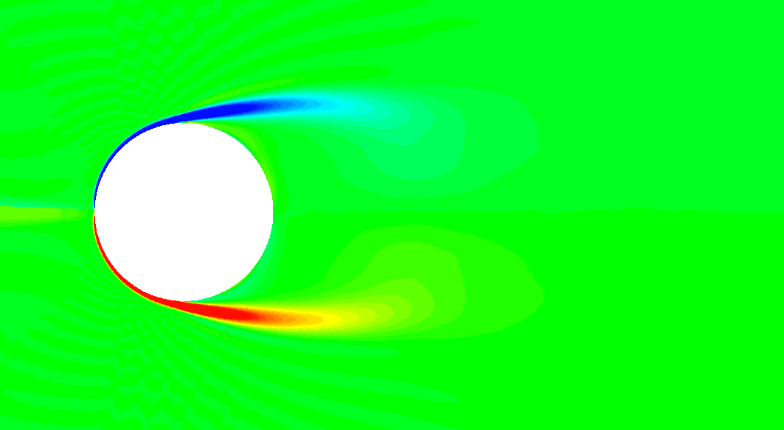
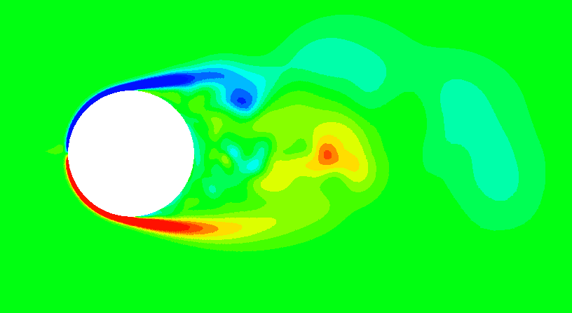
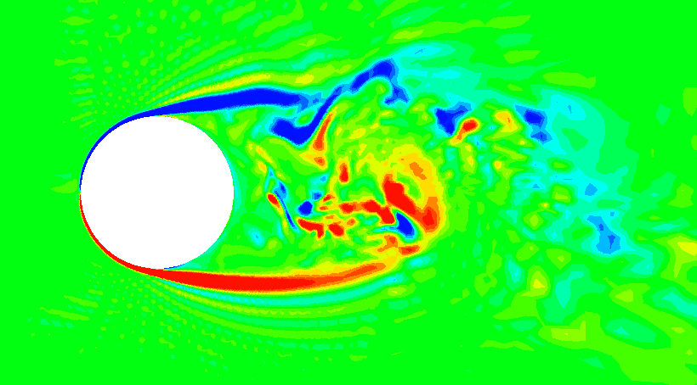
Hi-Fi CFD to resolve scales interaction
Energy
coarse
medium
fine
URANS → filter out high-freq motion e.g. turbulence → relies on turbulence model
URANS
Frequency∼Scales
LES → resolves part of high-freq motion e.g. turbulence → less dependent on turbulence model
LES
DNS → resolves all high-freq motion e.g. turbulence → no dependence on turbulence model
DNS
High-frequency (stochastic=turbulence)
Low frequency (deterministic=wakes/shocks)
Notes:
Let’s see what I can discover by switching to Hi-Fi, so if I go all the way to DNS and LES to scrutinize flow features of T/M relevance.

Slide 10
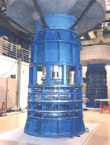
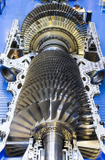
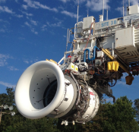
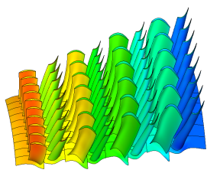
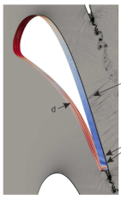
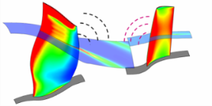
Hi-Fi CFD motivation
Mean line
Through flow
Single and multi blade-row
Steady RANS
Multi blade-row
Unsteady RANS
Simplified
Component
DNS & LES
Physics condensed in simple correlations
Summarize Company Specific Experience
Limited physics
modelled
Physics modelled
Full interaction
Most physics resolved
Physics measured
Physics modelled
Physics resolved
Steady/Unsteady
Steady/Unsteady
Wakes
Boundary layer
Steady/Unsteady
Wakes
Wakes
Boundary layer
Boundary layer
Notes:
After commenting on the challenge (white box) mention that Hi-Fi CFD can enable this.
Challenge: a) All design tools drive to same direction, for the right reason
b) What learned in the late design flows back to preliminary design
c) Reduce “ignorance-driven” margins

Slide 11
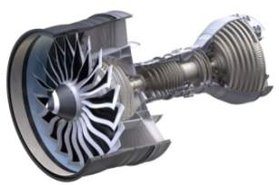
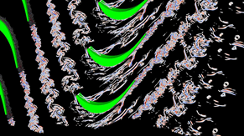
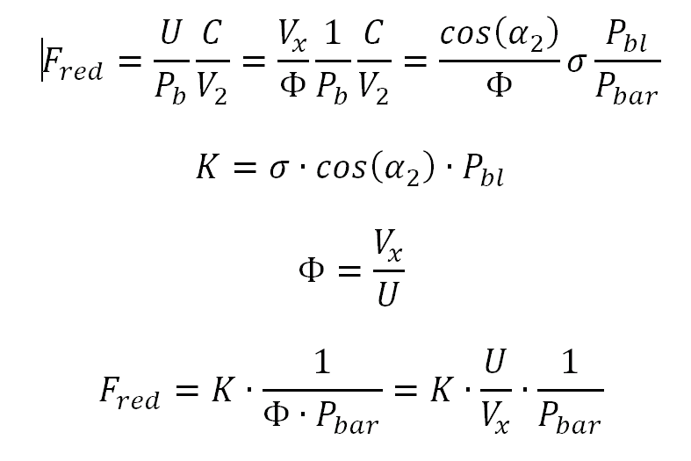
The low pressure turbine (LPT)
Endwall region
Secondary loss driven
R
Midspan region
Profile loss driven
S
T106: stalled w/o wakes
DNS
Losses
Profile X
URANS (pic.)
X: attached w/o wakes
Profile T106A
F_{red}
DNS to accurately predict wakes

Slide 12
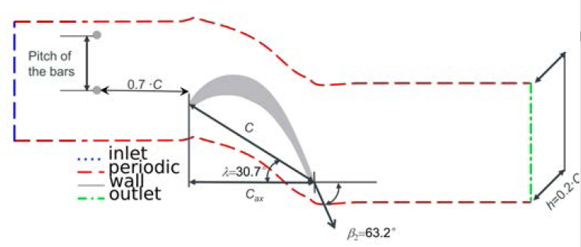
Unsteady effects:
Reduced frequency (DNS, Re=60-100k)
Moving bars fully resolved
T106A: 12 fully resolved DNS cases
Re2is Fred Tu
60k 0.00 ~0%, 1%, 4%
0.31 ~0.%, 4%
0.61 ~0%, 4%
1.22 ~0%
100k 0.00 ~0%, 4%
0.61 ~0%
1.22 ~0%
P_{b}
U
C
V₂
Compressible Direct Numerical Simulation of Low-Pressure Turbines: Part II – Effect of Inflow Disturbances, V. Michelassi, L. Chen, R. Pichler, R. D. Sandberg, ASME Journal of Turbomachinery, July 2015, Vol. 137.
Notes:
One of the key problems in T/M is the interaction between incoming wakes and blades. This is a typical problem where there is a strong interaction between a background turbulent flow field and discrete incoming wakes. Linear cascade tests with moving upstream bars showed quite interesting features, but they are often unable to provide enough resolution to identify the details of the loss generation mechanism.
That’s why in GE we decided to go for a design space investigation by using DNS changing Reynolds number, Reduced Frequency, and background turbulence intensity in a typical LPT profile.

Slide 13
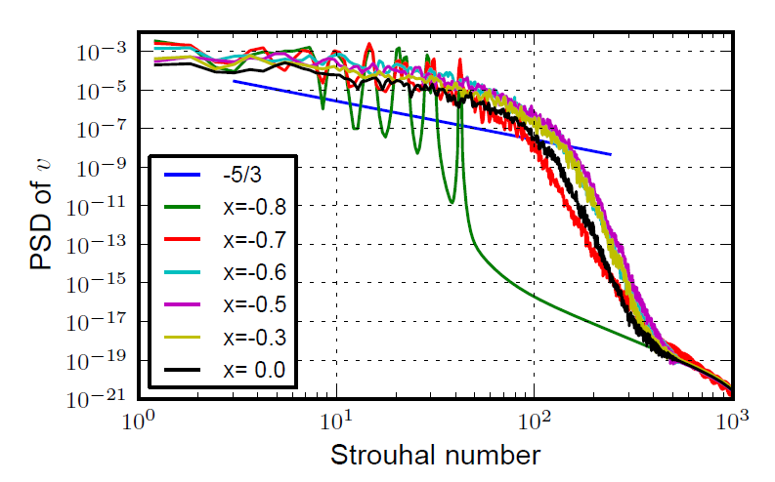
Is it a true DNS?
compressible
4th order compact finite differences in space
4th order in time
Wave-number optimized scheme
Highly parallel (CPU+GPU)
T/M features
Spectra of pitch-wise velocity component
Notes:
Incoming wakes are known to improve suction side boundary layer stability by energizing it. Incoming wakes, under specific conditions, can also help control, or reduce losses in presence of a stalled profile.

Slide 14
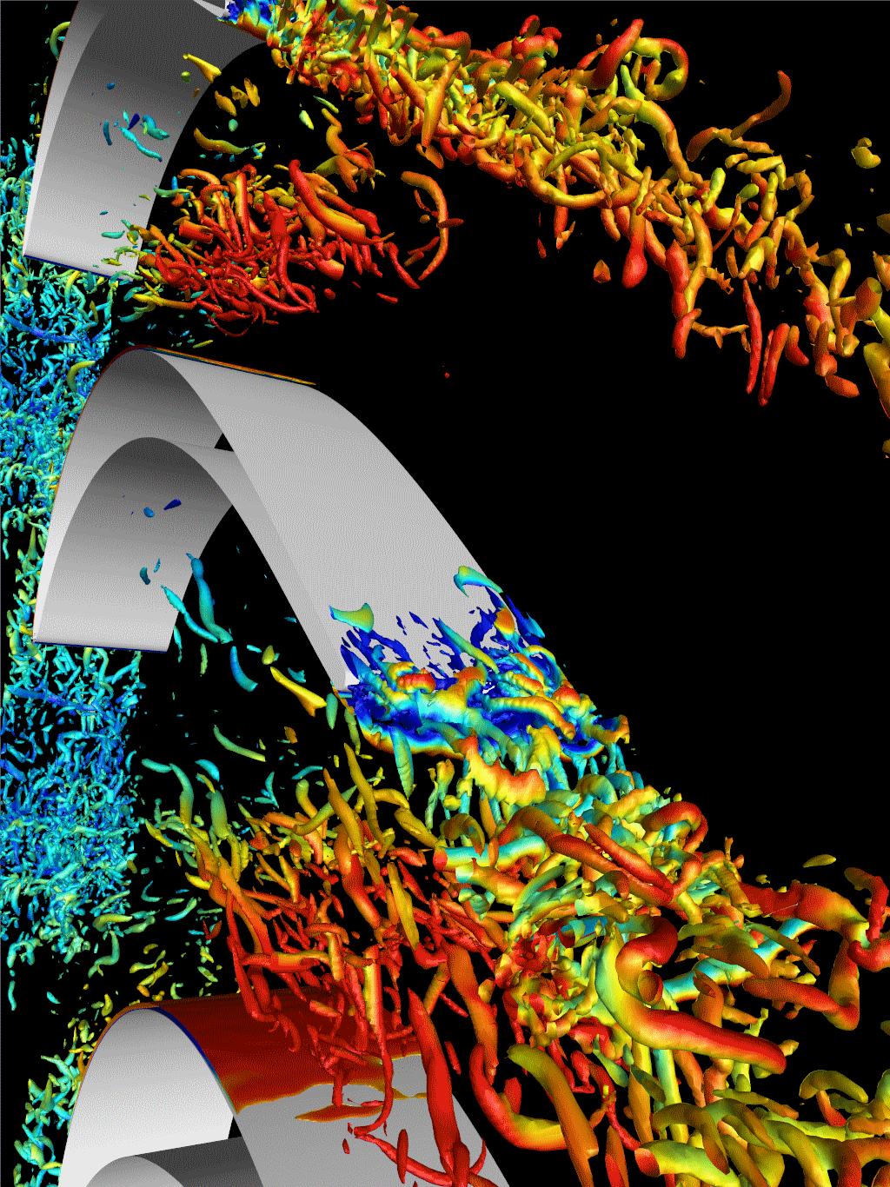
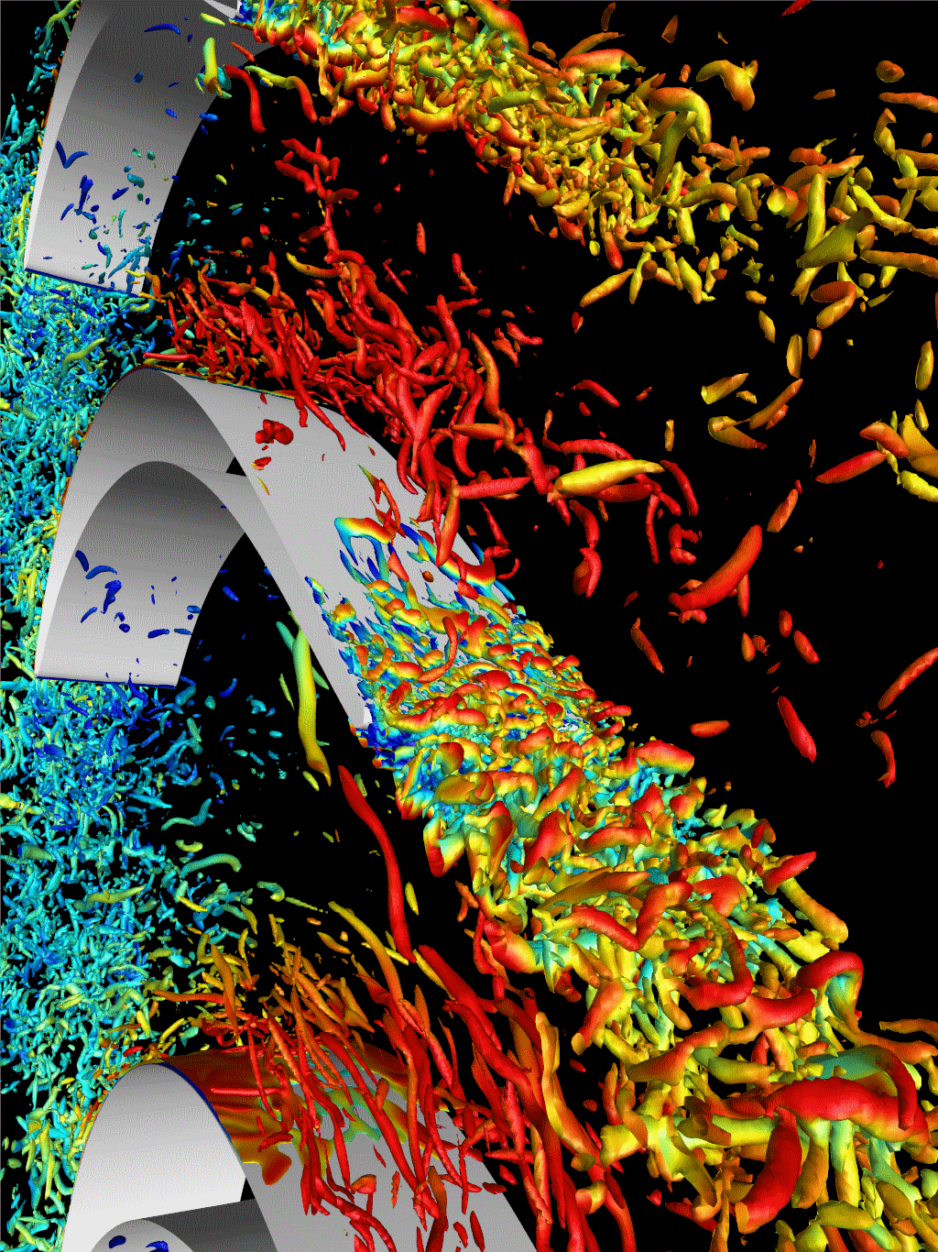
Unsteady flow field
`
`
Fred=0.31
Fred=0.61
Notes:
- Transitional type boundary layer
K-H structure → intermittent separation bubble
- Hair pin vorticies

Slide 15
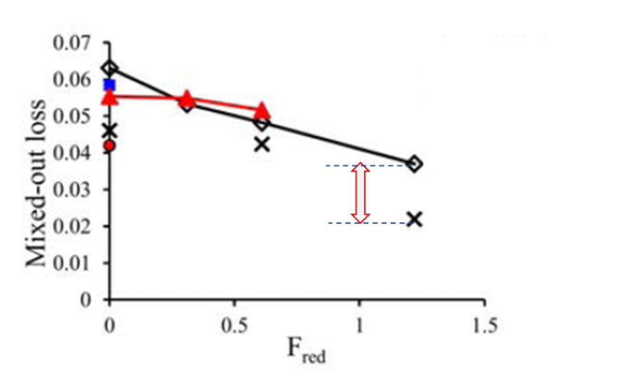
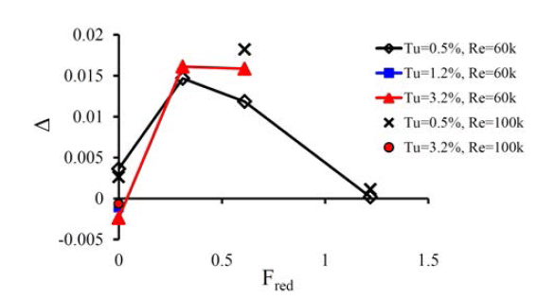
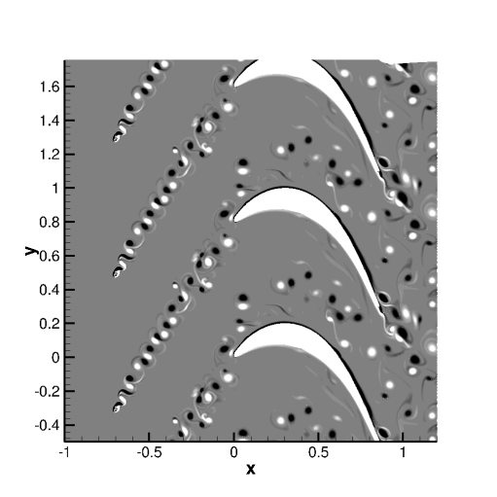
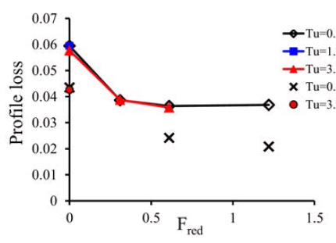
Unsteady losses: quantified by DNS
Time averaged
Mixed out
(A-full losses)
Mixed out losses
(A) – (B)
(B-conventional losses)
Control Volume
Time averaged
CV around profile
Profile losses (Denton)
2
1 & 3
2
Unsteady boundary layer
Wakes mixing upstream of l.e. (constant area)
Wakes mixing in the passage (variable area)
1% efficiency → 0.75% SFC ($B worth fuel burn)

Slide 16
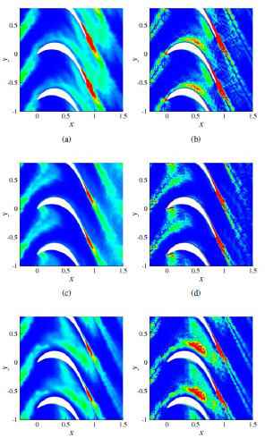
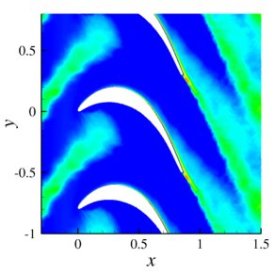
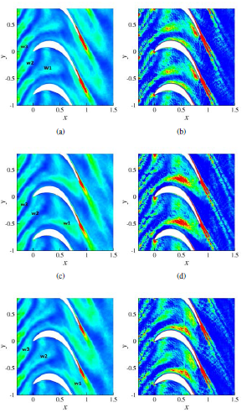
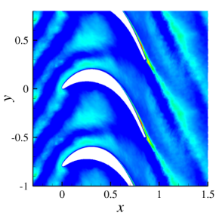
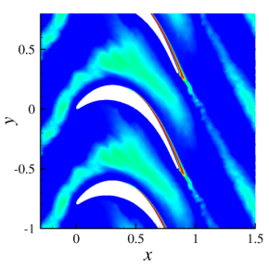
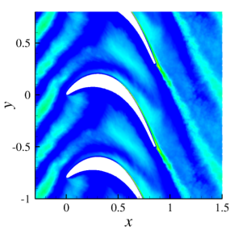
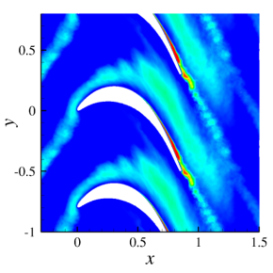
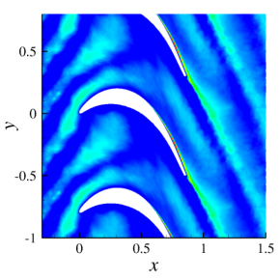
Core flow wake turbulence growth
Phase 1
Phase 2
Phase 3
TKE P_{k} S
Fred=0.31
TKE P_{k} S
Fred=0.61
Large-Eddy Simulation of Flow Around Low-Pressure Turbine Blade with Incoming Wakes, V. Michelassi, J. Fröhlich, W. Rodi, J. G. Wissink, AIAA Journal - AIAA J , vol. 41, no. 11, 2003.

Slide 17
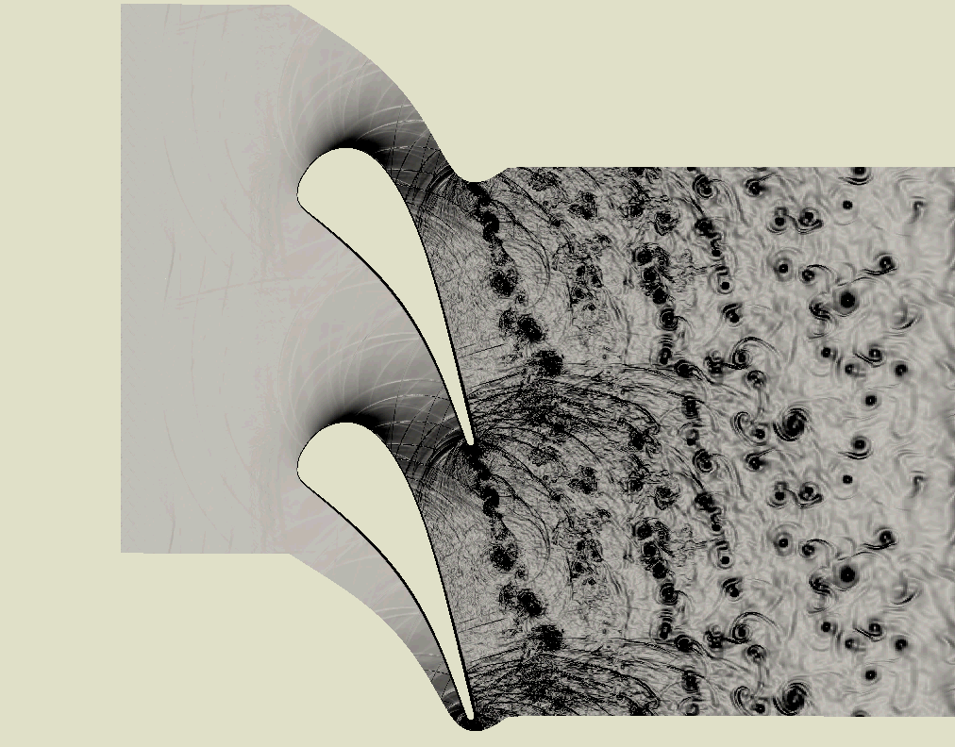
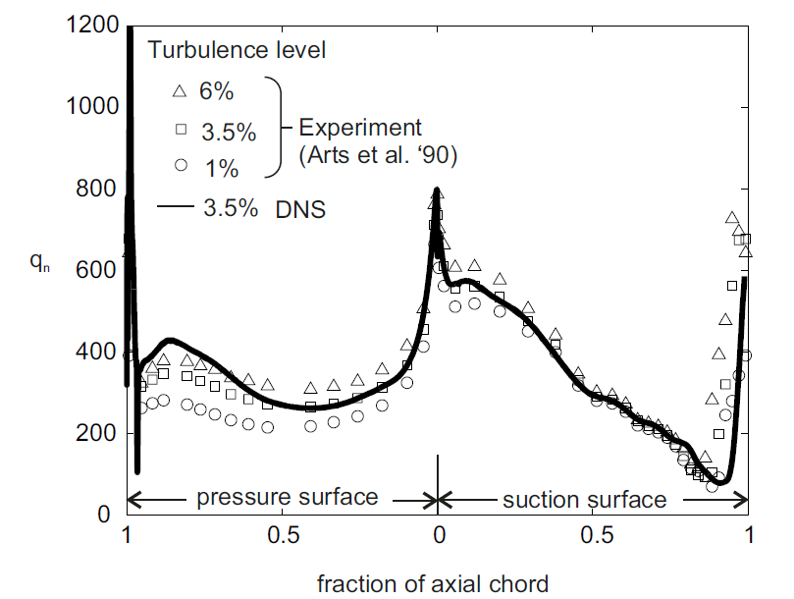
The high-pressure-turbine (HPT)
Compressible DNS
Re=570K
M_{is}=0.90
Direct Numerical Simulations of a High-Pressure Turbine Vane, A.P. Wheeler, R.D. Sandberg, N.D. Sandham. R. Pichler, V. Michelassi, G. Laskowski, GT2015-43133.
Understand heat transfer physics
Predict surface heat transfer
Design cooling system for efficiency and reliability

Slide 18
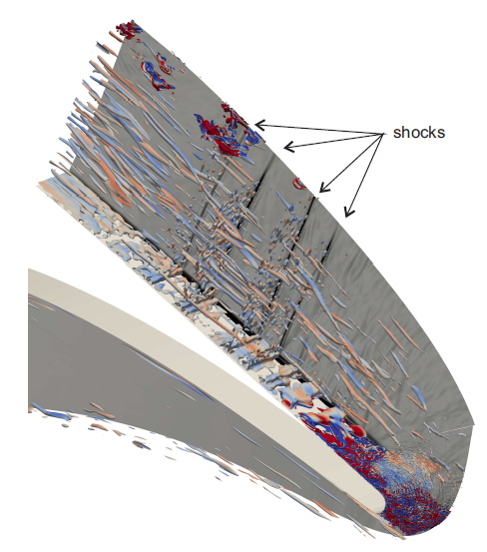
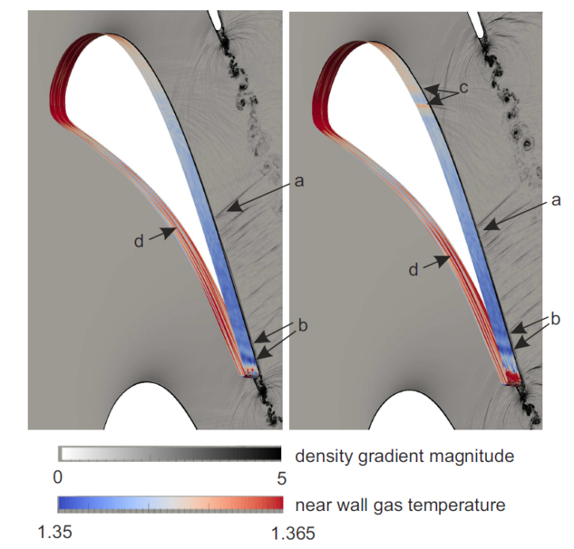
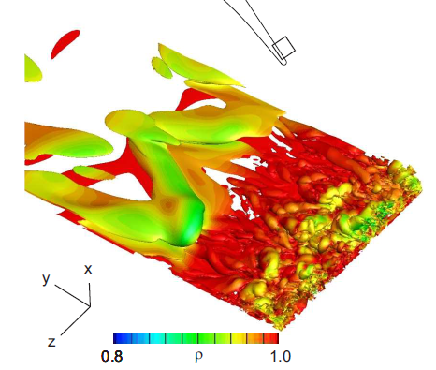
Pressure waves effect
c)
a)
d)
Pressure waves originated from t.e. vortex shedding
K-H instability triggered by t.e. vortex shedding
Local heat flux increase
Pressure-side streaks
b)

Slide 19
Some of the URANS fundamentals: Applicable?
Notes:
Now, many of the effects discussed so far might be missed, or partly captured, by URANS, but URANS is still and will be for long the workhorse in design loops.
So, before I try to improve URANS by using DNS and LES I must not forget some of the limitations stemming from modeling fundamentals.

Slide 20






Why we miss in URANS
Averaging:
Stochastic + deterministic unsteadiness
Anisotropy:
TKE and dissipation
model
DNS
Strain-stress:
Boussinesq law
Prandtl number:
Large RMS
Rotating frame:
Impact on turbulence

Slide 21



URANS: three step approach for LPT
Hi-Fi Data-base
New post-process
Model improve
Hi-Fi computer simulation
Large computational power
Unconventional data process
Accuracy top offenders
Formulate model entitlement
Validate with Hi-Fi DB
DNS Raw-data
Turbulent shear stress error of current models
Smallest possible turbulent shear stress error
Improvements are possible
Notes:
Now that some of the limitations are made clear, is there a chance to overcome part of them learning from the Hi-Fi results?
Keep in mind that any improvement to URANS might hold in a narrow design space, and there will be no general turbulence model…
That’s why we talk to LPT only…

Slide 22
Outlook
GE: large portfolio of T/M
  Propulsion
  Power generation
  Oil&Gas
  DNS
  LPT: explained unsteady loss generation fundamentals
  HPT: explained link btw heat transfer and pressure waves
Design
  DNS/LES still too computational demanding
  Heavily (U)RANS assisted → improve by using high-fidelity results
Thanks

